Slide 1



Great Lakes Nutrient Initiative (GLNI)
www.ec.gc.ca
The Phosphorus – Algae – Eutrophication Linkage in Lake Erie: The Urban Contribution(?)
Lake Erie Millennium Network Urban Effects Workshop
Brad Bass
RDG Office – Ontario, Environment Canada
March 2013

Slide 2

Contents
Background
Phosphorus 101
Phosphorus from Urban Areas
Links to Algal Blooms, Eutrophication and Hypoxia
The Future

Slide 3
Policy Framework
Great Lakes Water Quality Agreement
  Annex 4
Great Lakes Nutrient Initiative (GLNI)
Lake Erie Binational Nutrient Management Strategy

Slide 4

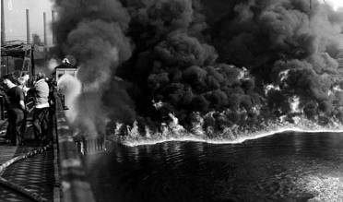

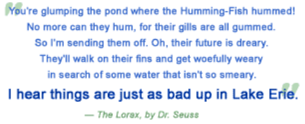
The Great Lakes Water Quality Agreement – centerpiece of action
- 3 -
Notes:
The Great Lakes Water Quality Agreement coordinates the actions of Canada and the United States in restoring and protecting the water quality of the Great Lakes.
At the time of the of signing, the first Great Lakes Water Quality Agreement in 1972, Prime Minister Trudeau described the state of the Great Lakes as a disgrace. Even Dr. Seuss couldn’t resist making a comment on the levels of pollution in Lake Erie.
.

Slide 5
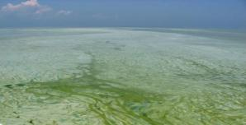
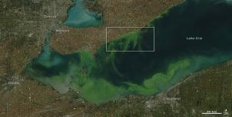
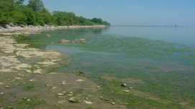
GLWQA Annex 4 Nutrients Commitments
Lake Ecosystem Objectives
    Maintain healthy nearshore and offshore algal communities
    Reduce extent of hypoxic zones,
    Reduce human health risk from Cyanobacteria toxins
Establish phosphorus objectives, loading targets and allocations
Implement programs and other measures to
    Manage excess phosphorus from point and non-point sources in urban and rural communities, industrial and agricultural sectors including;
Identify priority watersheds for nutrient control and develop management plans for these watersheds
Develop phosphorus reduction strategies and domestic action plans
5

Slide 6
Great Lakes Nutrient Initiative
Program established to improve nearshore and ecosystem health, and better address the presence of phosphorus in the Great Lakes.
Focused on toxic and nuisance algae in the nearshore and open waters of Lake Erie.
Science and policy approaches developed through the Initiative will be transferable to the other Great Lakes.
Urban, Agriculture, C/B analysis, Engagement
4 years (2012-2016)

Slide 7
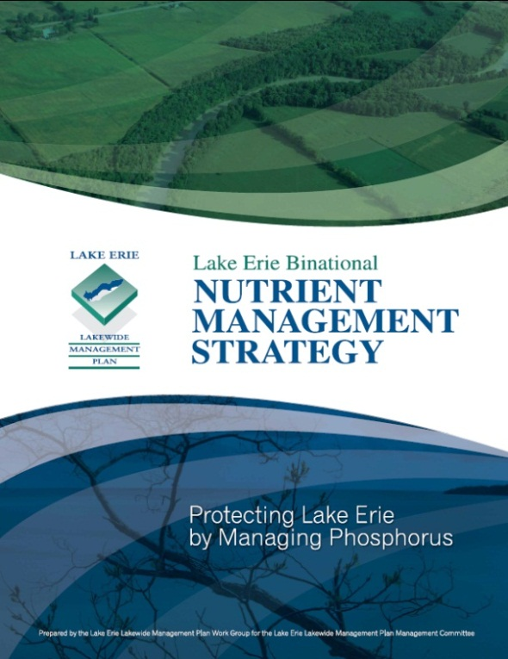
Lake Erie Binational Nutrient Management Strategy
Sets goals, objectives, quantitative targets and actions needed to improve current conditions and prevent further eutrophication of Lake Erie
The focus is phosphorus because it is the primary nutrient causing excessive algae
Key Principles for implementing the Strategy: Adaptive Management, Precautionary Principle, Pollution Prevention, Shared Responsibility, Accountability, Work Together (integration and cooperation), Promote Awareness
Lake Erie LaMP Nutrient Goals:
    Nutrient inputs from both point and non-point sources
    are managed to ensure that ambient concentrations
    are within bounds of sustainable watershed management
    and consistent with the Lake Erie Vision.
    A substantial reduction in the current levels of algal biomass
    to levels below a nuisance condition in Lakes Erie, . . .

Slide 8
Phosphorus Essentials
Essential for life, crucial for global food supply
We contain approx. 1.5 kg of P
No known substitute
Cannot be manufactured, cannot be destroyed
We excrete 3-4 grams daily in urine
Cows, hogs exrete 15 – 20 times that amount
95% of high quality, economically recoverable P in 5 countries, a group that does not include Canada
Courtesy of D.S. Mavinic, UBC

Slide 9
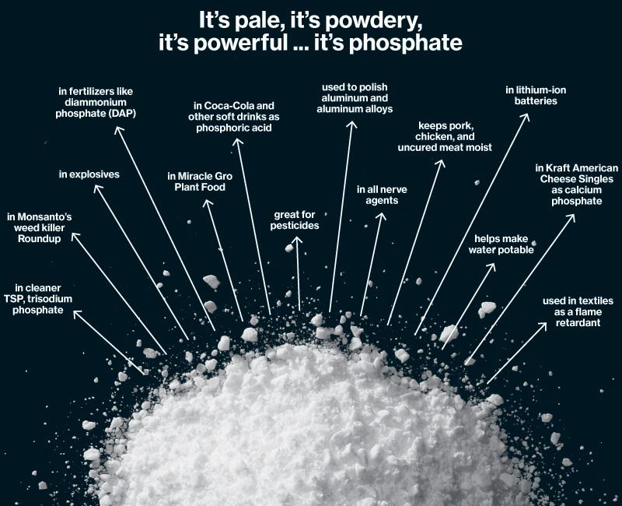
Looking for Keywords . . . Look Everywhere
Courtesy of D.S. Mavinic, UBC

Slide 10
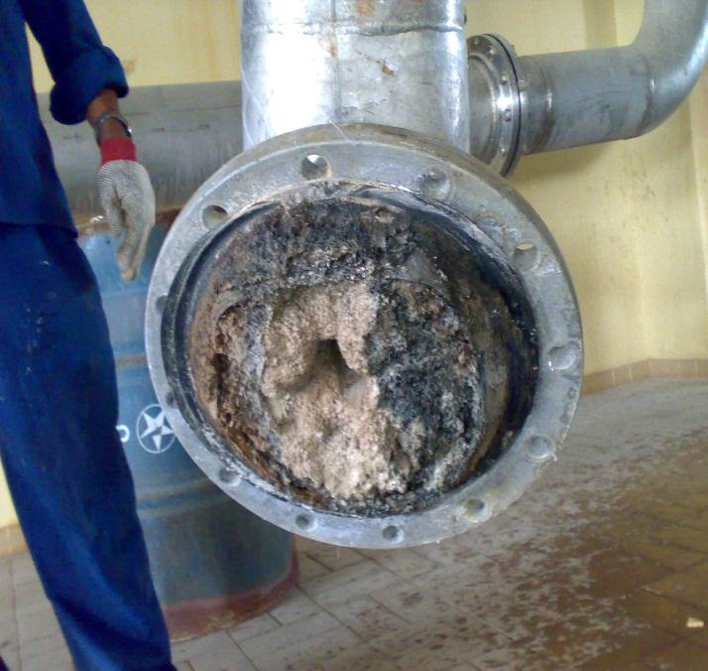
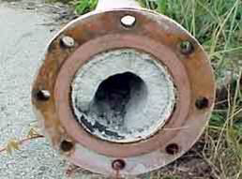
Including in our Urban Drainage
Struvite – inorganic fertilizer rich in P
Forms as solid matrix in many biological WWTPs
Resulting in plugging of pipes and pumps
Courtesy of D.S. Mavinic, UBC

Slide 11
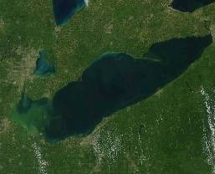
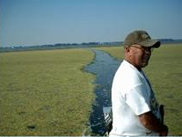
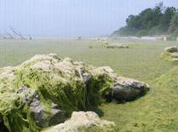
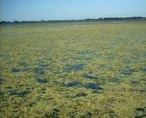
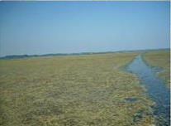
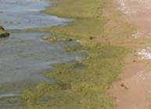
Phosphorus –increases aquatic plant growth
too much leads to toxic and nuisance algae
- 6 -
Notes:
New commitments have also been added in relation to toxic and nuisance algae, which fouls beaches, degrades fish and wildlife habitat, makes water unsafe for drinking and swimming, and can even clog water intakes and force plant shutdowns as occurred in 2007 at Ontario Power Generation’s Pickering Nuclear Generating Station.
Algae was a problem which threatened Great Lakes water quality in the 1960s and 70s, and which was successfully brought under control through bans on phosphorus in detergents, through investments in wastewater treatment, and through improved agricultural management practices.
But the problem has returned in many nearshore areas of Lakes Ontario, Huron and Michigan, and is most severe in both nearshore and open waters of Lake Erie.
So why has the problem returned? Well more people living in the Great Lakes basin and contributing their waste to the lakes is one reason. So too is agricultural intensification. But other factors are also believed to play a role. Climate change contributes to algae growth through warmer water temperatures and longer growing seasons. And even aquatic Invasive Species are also believed to play a role. By filtering particulates out of the water, zebra mussels contribute to increased water clarity allowing increased penetration of sunlight, and because the zebra mussel is predominantly found in shallow waters, that filtering action traps phosphorus as it enters the lakes, and holds it in the nearshore zone, enriching these waters and promoting large scale algae growth.
We believe that we can once again control the growth of algae by limiting the inflow of phosphorus. But by how much? Too much of a reduction and we could reduce the productivity of the lakes, adversely impacting fish populations. And how much of a reduction should each country contribute to the solution? And further, within each country how much of that reduction should come from urban sources such as lawn fertilizers – from municipal wastewater treatment plants – or from agricultural practices? And what are the best means of achieving these reductions?
The Amended GLWQA commits Canada and the United States to new science to understand the algae issue and to develop new targets for reduction of toxic and nuisance algae through the control of phosphorus discharges. Emphasis is being placed first on Lake Erie where the problem is greatest. New targets will be developed for other Great Lakes as required.
The Government of Canada has launched the Great Lakes Nutrient Initiative which provides $16 million over four years to develop new phosphorus reduction targets and to assess the options for achieving phosphorus reductions in an equitable and cost effective manner.
It has also renewed the $29 million Lake Simcoe Clean-up Fund. This fund supports community based initiatives which demonstrate the effectiveness of on the ground actions to reduce phosphorus discharges.

Slide 12
GLWQA Annual Phosphorus Targets Met

Slide 14
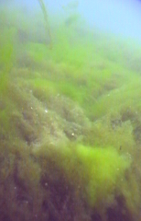
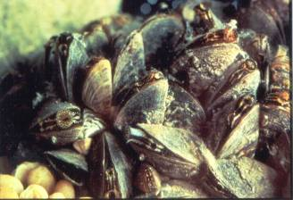
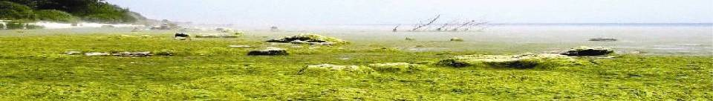
Excessive Nutrients
Efforts in the 1970s to reduce phosphorus loadings were largely successful. However, an increase in dissolved phosphorus has led to a re-emergence of excessive algae and cyanobacteria blooms in the Great Lakes.
The increasing proportion of the total phosphorus is dissolved and thus biologically available to fuel nearshore algal blooms.
Cladophora fouling of shoreline has been reported for Lakes Huron, Michigan, Erie and Huron.
Cyanobacteria blooms occurring in Lakes Michigan, Huron, Erie, and Ontario.
Plectoma Lyngbya blooms identified in the western basin of Lake Erie.
Todd Howell
Rondeau Bay LE
Scott Higgins
Notes:
Efforts in the 1970s to reduce phosphorus loadings were largely successful. However, apparent increases in bioavailable phosphorus have led to a re-emergence of excessive algae and cyanobacteria blooms in the Great Lakes and there is corresponding concern about the algae’s potential to produce toxins, foul beaches and clog water intakes.
In addition zebra and quagga mussels have significantly changed the cycling of nutrients and food web dynamics in the lakes. There is evidence that less bioavailable forms of phosphorus entering the lakes are being converted to ones that increases the growing ability of algae.
In addition, Water temperatures have increased and, there has been a reduction in the extent and duration of ice cover over the past 50 years. Warm water and high P concentrations have been shown to favour the growth of toxic forms of algae in the western basin of Lake Erie
There are ongoing science investigations to determine how these changes are interacting and contributing to the re-emergence of algal blooms in locations throughout the Great Lakes Basin.
Cladophora blooms have been widely reported in all lakes, except Lake Superior where substrate, light, temperature and nutrient conditions are suitable.

Slide 15
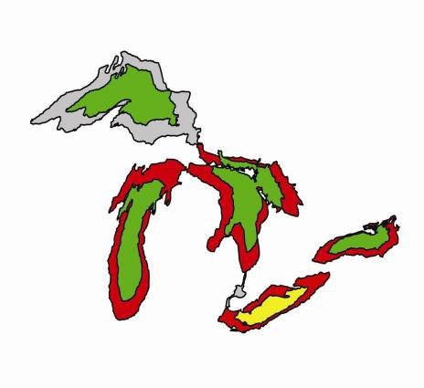
Excessive Phosphorus
Total Phosphorus in the Nearshore
Lake Huron and Lake Ontario: some nearshore areas and embayments experiencing elevated levels
Lake Erie: extensive lawns of Cladophora are common place over the Eastern nearshore lakebed
Good
Fair
Poor
not assessed
Status of phosphorus can be quite different between the nearshore and offshore waters of each lake
Notes:
Phosphorus Concentrations and Loadings
Excessive inputs of phosphorus to the lakes from detergents, sewage treatment plants, agricultural runoff, and industrial discharges can result in nuisance algae growth. Efforts that began in the 1970s to reduce phosphorus loadings have been largely successful. However, in some locations, phosphorus loads may be increasing again, and an increasing proportion of the phosphorus is a dissolved form that is biologically available to fuel nearshore algal blooms.
The goals of phosphorus control are to maintain an oligotrophic state in Lake Superior, Lake Huron and Lake Michigan; to maintain algal biomass below that of a nuisance condition in Lakes Erie and Lake Ontario; and to eliminate algal nuisance growth in bays and in other areas wherever they occur (Great Lakes Water Quality Agreement (GLWQA) Annex 3, United States and Canada 1987).
The status and trends of phosphorus can be quite different in the nearshore waters compared to the offshore waters of each lake.
Superior: Nearshore areas were not assessed, but the open water areas remain at or below expected levels.
Michigan: Phosphorus Concentrations may exceed guidelines in nearshore waters for at least part of the growing season.
Huron AND Ontario: Most offshore waters meet the desired guideline, but some nearshore areas and embayments experience elevated levels which likely contribute to nuisance algae growths such as the attached green algae, Cladophora, and toxic cyanophytes such as Microcystis.
Erie: Phosphorus concentrations in the three basins of Lake Erie fluctuate from year to year and frequently exceed target concentrations. Extensive lawns of Cladophora are common place over the nearshore lakebed in parts of Eastern Lake Erie and are suggestive of phosphorus levels supportive of nuisance levels of algal growth.

Slide 16
What are local-scale interactions between Dreissena and benthic algae?
Patricia Armenio
Department of Environmental Sciences and the Lake Erie Center
University of Toledo
System level
Increased light penetration
Local level
Resource importation
Structural complexity
Benthic Primary Production
Notes:
Effects happen at distinct spatial scales. Dreissena are filter feeders, increase water clarity, increase light penetration, can enhance benthic algal growth. Neashore shunt states that Dreissena are responsible for nearshore habitat modification in Great Lakes

Slide 17
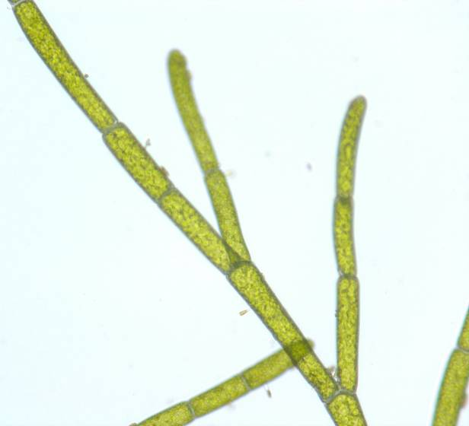
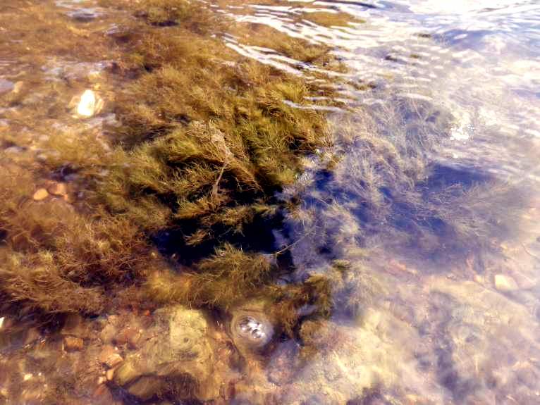
Cladophora glomerata
Green alga
Requires relatively high light and hard substrate
Blooms common from
1950s through early 1980s
Return of blooms since mid- 1990s not associated with P loading
Dreissena are filter feeders, increase water
clarity, increase light penetration, can enhance benthic algal growth.
Higgins et al. 2008

Slide 18
Zebra and quagga mussels are believed to be sequestering phosphorus in the
nearshore, maintaining a supply of soluble phosphorus in the nearshore
area, where they fuel the resurgent Cladophora growth and create hard surfaces
that allow greater algae growth.

Slide 19
EUTROPHICATION
The nutrient enrichment of an aquatic ecosystem.
Natural Eutrophication -- a process that occurs as a lake or river ages over a period of hundreds or thousands of years.
Cultural Eutrophication -- a process that occurs when humans release excessive amounts of nutrients; it shortens the rate of aging to decades.

Slide 20
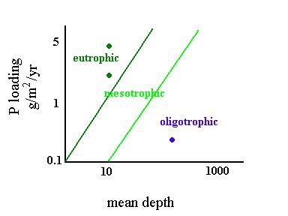
Phosphorus and Lake Classification
The productivity of a lake is often determined by its P loading and its volume (mean depth)

Slide 21
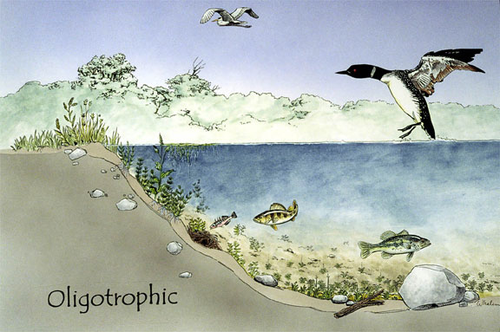
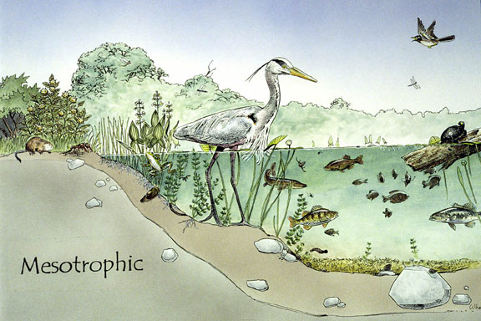
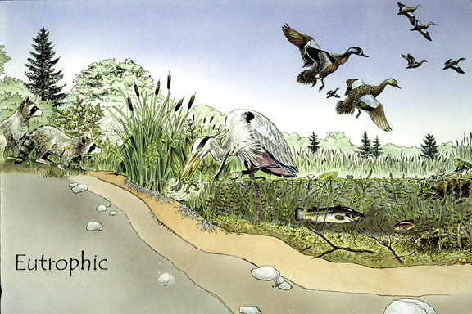
Natural Eutrophication
Lake classification based on
nutrient content and production
of organic matter. Oligo- nutrient
poor; meso- middle nutrient;
eu- nutrient rich.

Slide 22
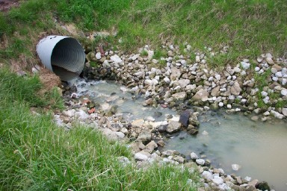
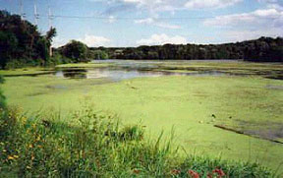
Nutrients Stimulate Algal Blooms
Nitrogen and phosphorus from runoff and effluents or decay of organic matter stimulates aquatic plant growth.
In particular, algal “blooms” give the water a green or blue-green color.

Slide 23
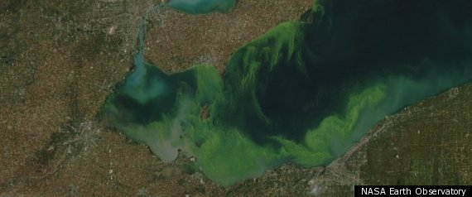
Harmful Algal Booms
October 14, 2011
Notes:
After being largely absent in the late 1980s and early 1990s, harmful algal blooms have been reappearing in locations throughout the Great Lakes with the exception of Lake Superior. Lake Erie is the most severely impacted as shown here in an image from last fall.
Harmful algal blooms are those floating out in the water that produce toxins implicated in human illnesses. There is some relief knowing that these toxins are eliminated by municipal water treatment facilities.

Slide 24
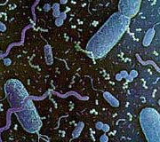
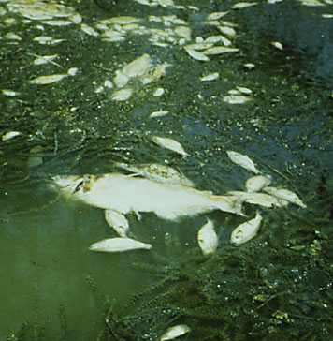
Cultural Eutrophication - Algae Dies, Bacteria Grow, Deplete Oxygen, Fish Die
Algae exhausts nutrients and dies.
Bacteria thrive on organic decay of algae and lower dissolved oxygen. Rapidly growing bacterial populations need exponentially increasing amounts of oxygen.
Hypoxia / Anoxia: Fish and invertebrates die when oxygen gets too low.

Slide 25
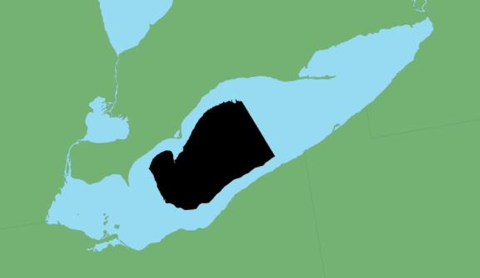
Lake Erie Dissolved Oxygen
Credit: U.S. Environmental Protection Agency
.
Maximum area of anoxia measured in 2010
Notes:
Areas of Lake Erie have been experiencing anoxic conditions as far back as the 1930s. The concern though, is the increase in total area and duration of these zones in the last decade.
The average dissolved oxygen concentrations in the bottom waters of the Central basin may reach less than 1 milligram/liter. This is a concern because few species can tolerate such low levels. At these concentrations, some people call it a “dead zone” shown in black.

Slide 26
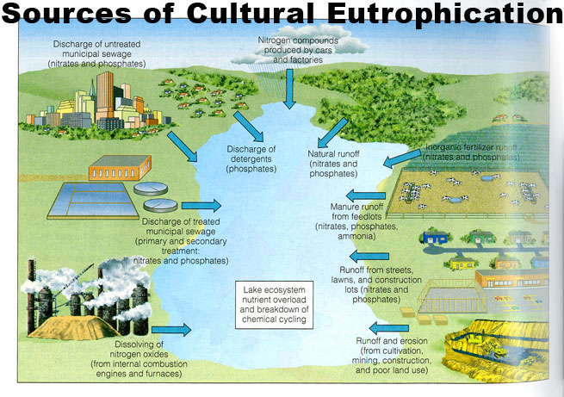
Point and Nonpoint sources
thinkquest.org

Slide 27
Courtesy Jiri Marsalek

Slide 28
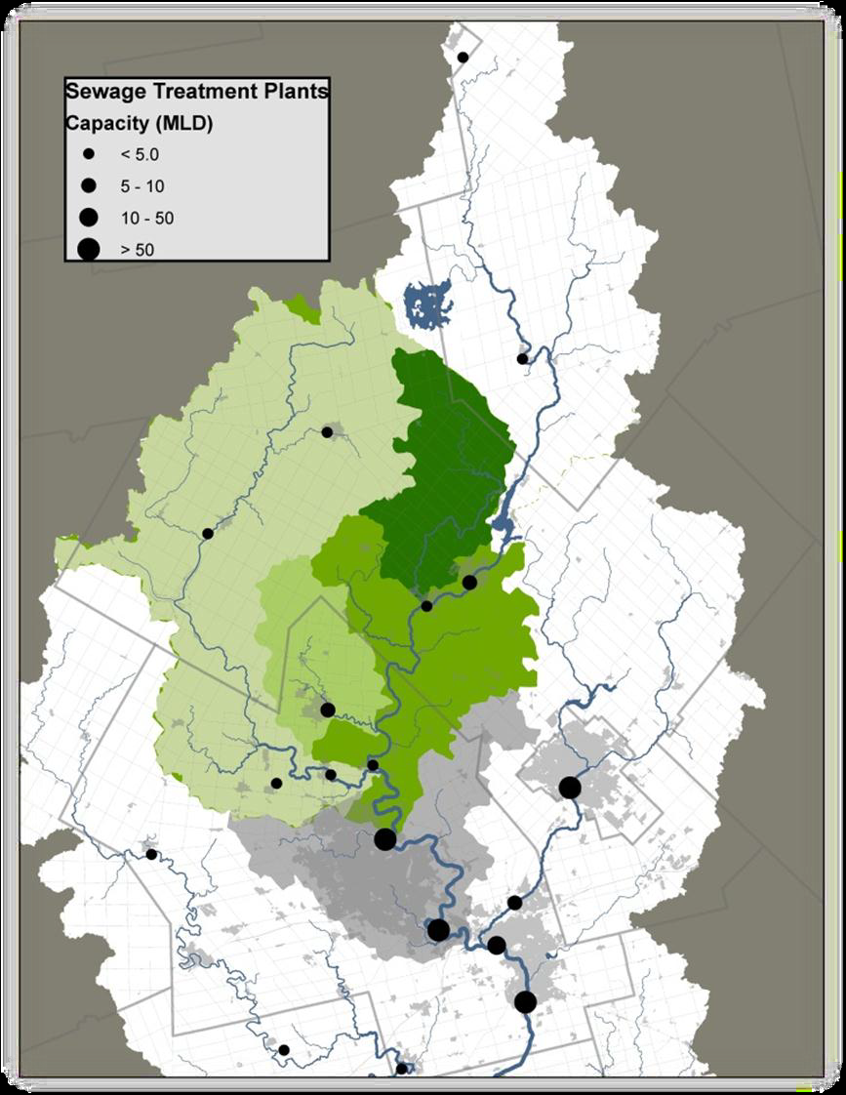
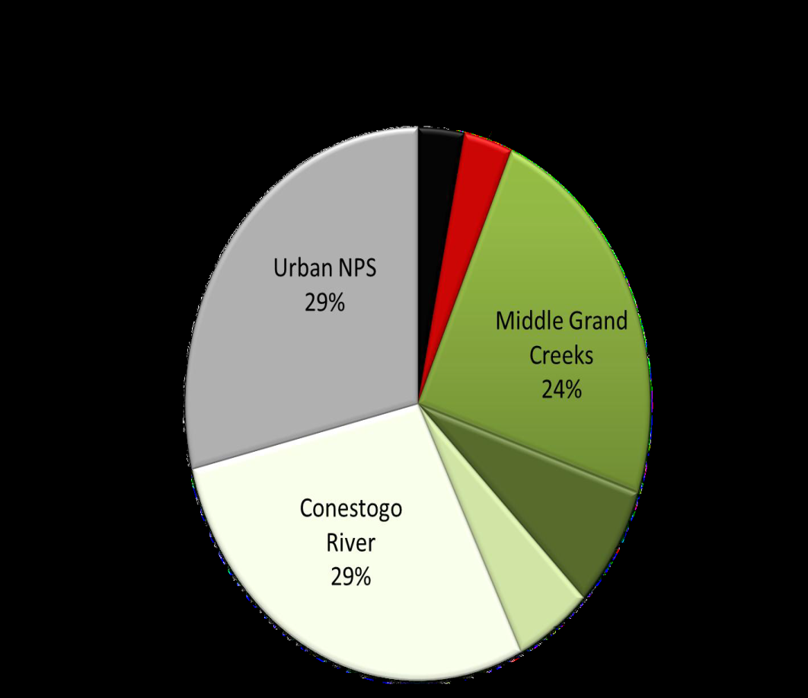
Are Urban Areas Important –
Grand River Example
NPS in the Spring
Courtesy of GRCA, Water Mgt Plan, Partners Workshop, 2013

Slide 29
Where Does it Come From –
Grand River Example
Courtesy of GRCA, Water Mgt Plan, Partners Workshop, 2013

Slide 30
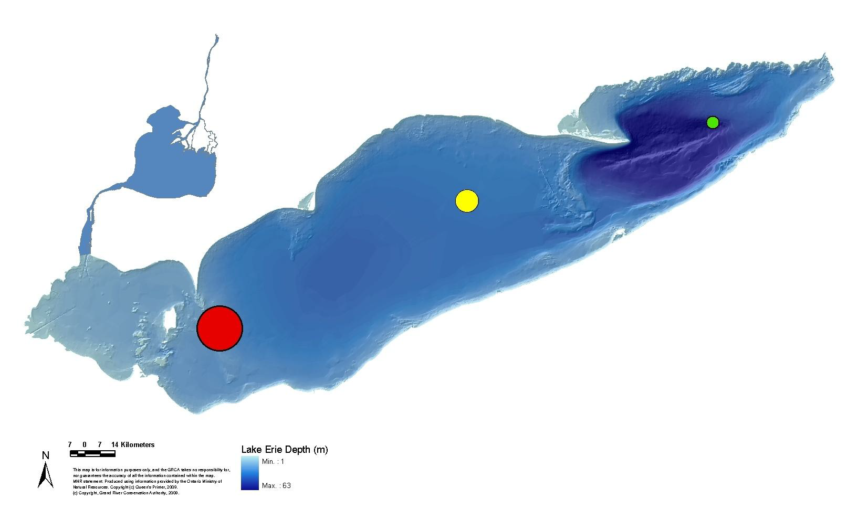
Estimated P Load to Lake Erie

Slide 31
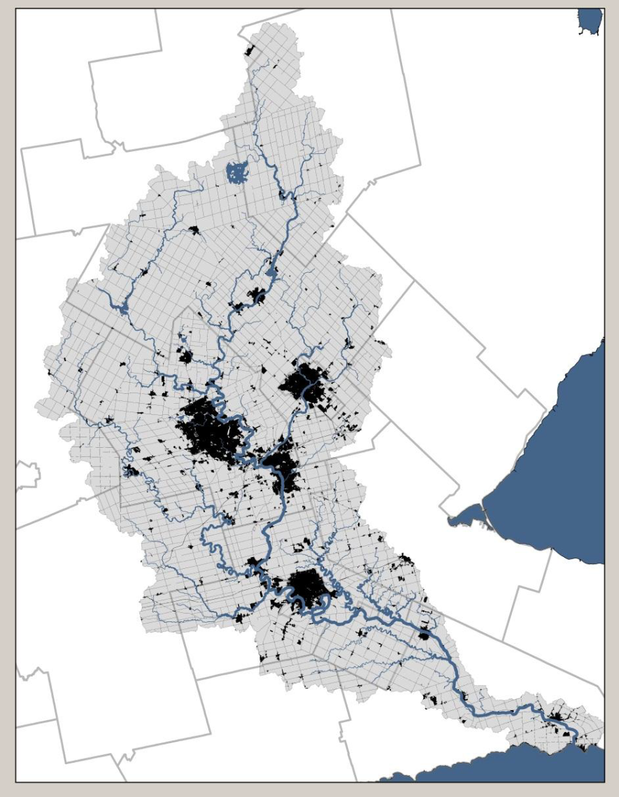
Future Concerns – Urban Growth
80% of population in 5 Cities
30 WWTPs
Expansion of smaller, communities, currently on septic systems
Waterloo
Guelph
Kitchener
Courtesy of GRCA, Water Mgt Plan,
Partners Workshop 2013

Slide 32
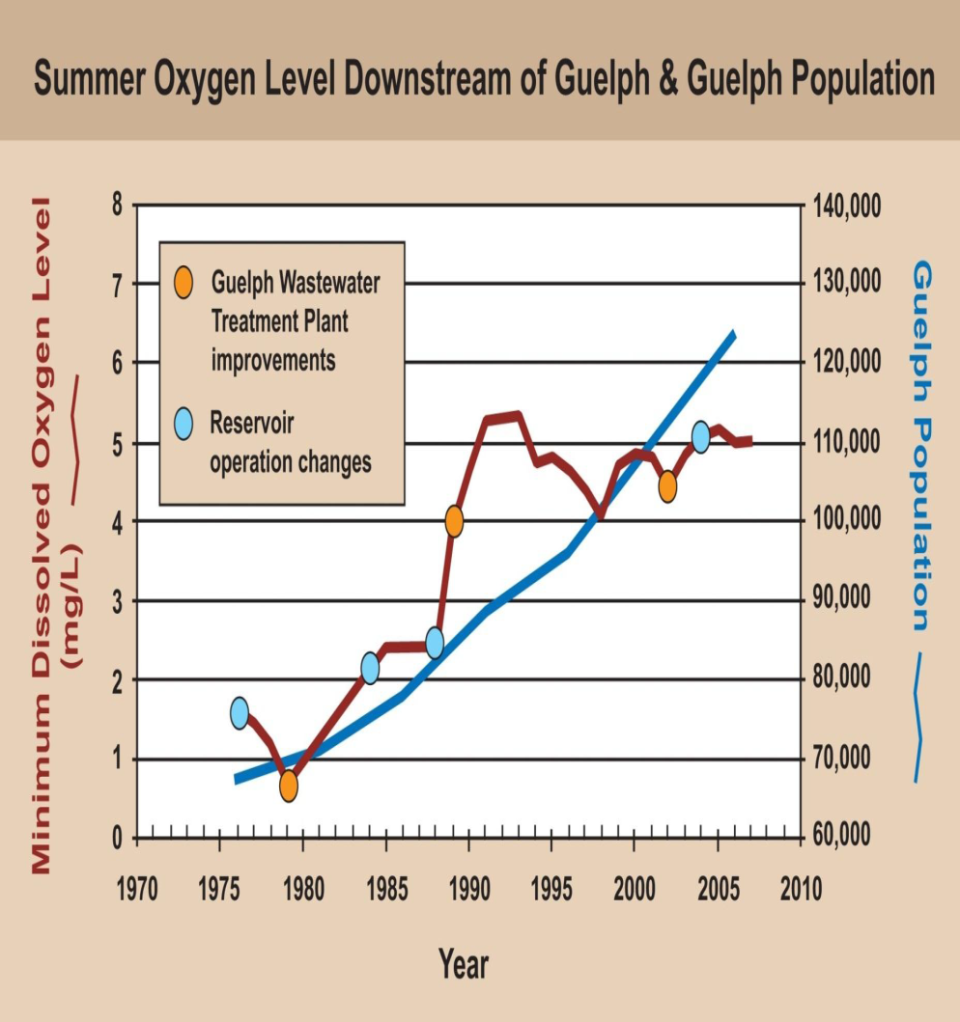
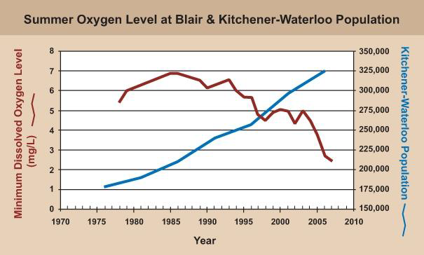
Future Concerns – Urban Growth(?)
Courtesy of GRCA, Water Mgt Plan, Partners Workshop 2013

Slide 33



Future Concerns – Climate Change
Decreasing Snow:Rain ratio in Winter
Rain on frozen or not-frozen, bare soils
Drier Summer with more sever storms
Stable late Summer / Fall lake temperatures delay overturning

Slide 34
CONVINCING
CLIENTS
PEOPLE

Slide 35



www.ec.gc.ca

